Slide 1
General Hardware Description
The Hydrosystem hardware is based on the raspberry pi3.
The user interface is based on web server. Wifi is mandatory for the system to work.
Hardware as the Clock, Temperature, humidity sensors etc. Are not mandatory but highly recommended to be implemented.
Relay are necessary to manage the actuators
All the project is designed to be cheap, save money as much as possible and still reach the target :)
The SW is open source hopefully everybody con contribute to it

Slide 2
Minimal hardware Setting
To test the hydrosystem you only require the raspberry pi3 (or the raspberry pi2 with correct wifi adapter)
In this hardware configuration you can have a look at the interface and evaluate if proceeding in adding more component
If you have a Usb webcam, then try to connect to the USB of RPI

Slide 3
Recommended hardware Setting
This hardware setting will use much of the system capabilities. This will allow to use Temperature and humidity sensor, keep the right time with Hardware clock in case the system is not connected to internet. Enable to use some actuators using a group of relays. With such relays you can switch on/off the watering valge, pumps, etc.

Slide 4
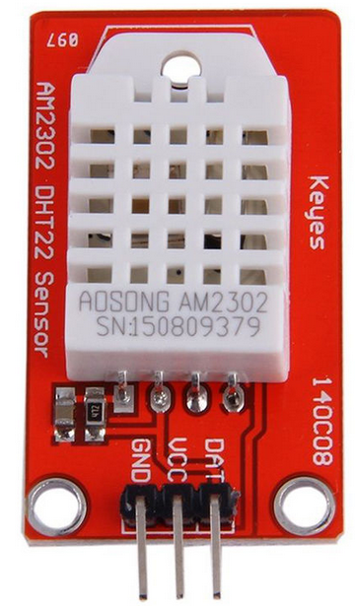
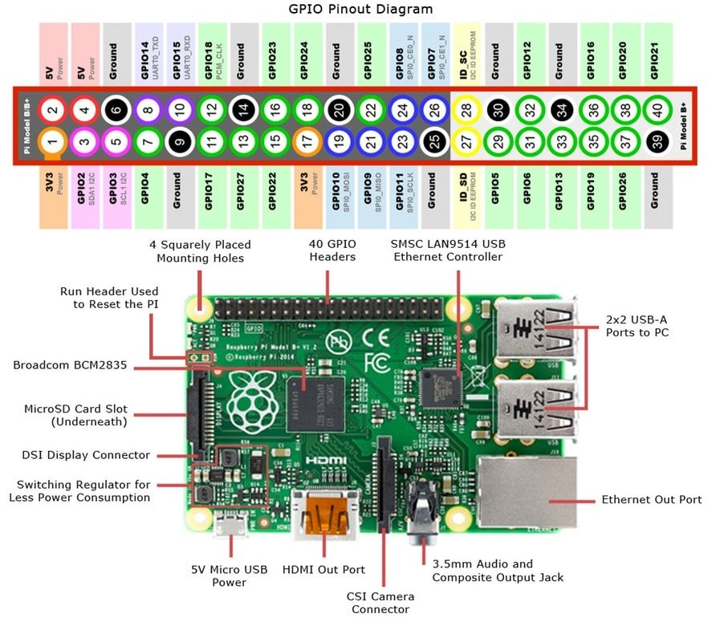
Connect the Humidity and temperature sensors
The Hydrosystem SW is designed to be compatible with the DHT22 sensor, this sensor is quite inexpensive and provides good accurancy for both temperature and Humidity. Below the connection schema:
Connect VCC to +5Vdc, the GND to ground and the DAT (or OUT) to the pin18. Pin18 is also numbered as GPIO24.
The board in the picture AM2302 includes the DHT22 sensor and a couple of pull-up resistors required for the connection to the RPI. Current price in the market less than 5eur

Slide 5
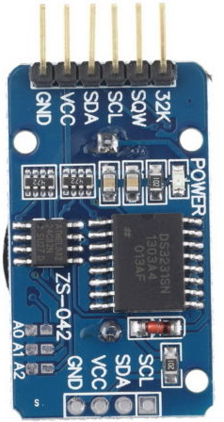
Connect the Hardware Clock
The Hardware clock is important if the RPI does not have a stable IP connection or the Hydrosystem works offline. It is highly recommended to add one of it to the project. The Real time Clock RTC based on the DS3231 chipset is inexpensive (less than 3 eur) and is sold together with battery.
Connect VCC to +5Vdc
GND to ground
SDA to pin3 also called GPIO02
SCL to pin5 also called GPIO03

Slide 6
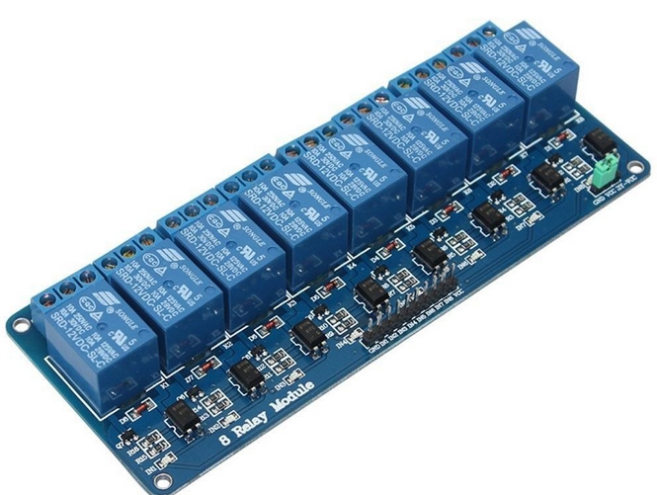
Connect Relays
Relays are used as switches for the actuator. The 5V relays in the market are compatible to be directly connected with RPI if they have the optocoupler, most of them have the optocoupler. The 8 relays board can be found for less than 10 eur. If 8 relays are not necessary, then also board of 4 or 2 relays are available.
The picture shows the 5v 8relays board.
Highlighted in the red circle the optocoupler
The relay logic is commonly negative, this means that they are activated when the input is low. This is not a problem for the SW as this parameter can be set

Slide 7
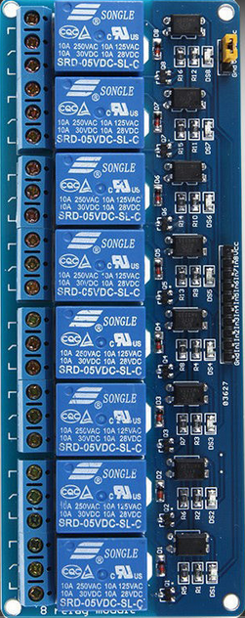
Connect the Relays board
The relays have 5v input. It is recommended for the actuators to use max 12V DC as security measure. Up to 2 relay arrays with 8 relays each can be connected
Connect VCC and GND which are normally located at the ends of the input line
Following GPIO pins for the connection with relays input:
Relay1
GPIO 5, 6, 13, 19, 26, 12, 20, 16
Relay2
GPIO 14, 4, 15, 18, 17, 27, 23, 22

Slide 8
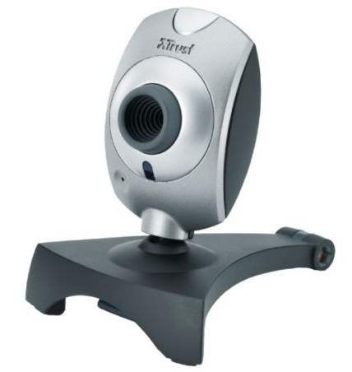
Connect webCam
The system is able to take some pictures, both with Rasicam of standard usb webcam, You can insert as much webcam as the USB available
NOTE: not all the USB webcam are compatible with raspberry even if most of the modern cameras are. On internet there is a list of compatible webcams for RPI, anyway only few are incompatible.

Slide 9
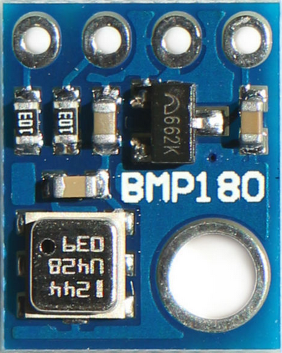
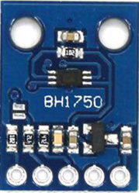
Atmospheric pressure and light sensors
If you are interested in monitoring the barometric pressure and the light intensity, it is possible to include two sensors that are already supported by the SW: the BH1750 for light and the BMP180 for the pressure. Both of them have the I2C interface and can be connected in parallel with other i2C devices. The below schema do not show the VCC and GND which should be connected to 5V supply.

Slide 10
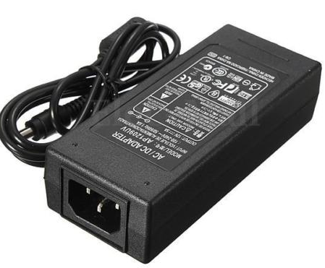

Hydrosystem Power items
Power is supplied to the system using a 12V-5a adapter and a 12V to 5V DC-DC converter 3A.
The adapter cost less than 10 eur
The DC-DC converter less than 5 eur
12V DC power supply 5A
12V DC to 5V DC converter
5V – 3A output

Slide 11
Hydrosystem Power setting
One very important aspect of the project is the power supply. I found all required water valve and pumps working at 12vdc. For safety reason I choose the 12V for the actuators and 5vdc for raspberry, sensors and relay. Below the setup:
12V
5V
12V – 5A
power adapter
5V – 3A
DC-DC converter
Raspberry PI
Relay Input
Relay Board
Sensors
Relay output
NOTE: The GPIO ground should be connected with the common ground.
Valve/Pumps

Slide 12
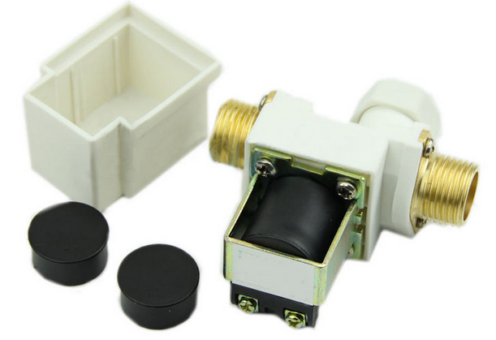
Electrovalve 12V
Below the 12v DC evectrovalve I have used in my setup. Cost no more than 10 eur each.
Found also the ¾ inch valve which is preferable due to the ¾ connection is more common in irrigation applications. Price around 6 eur each.

Slide 13
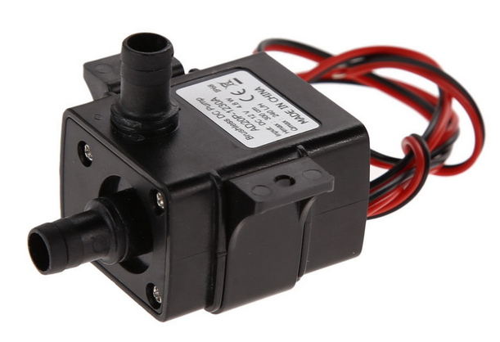
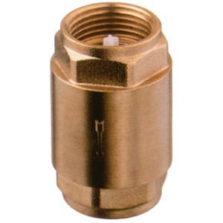
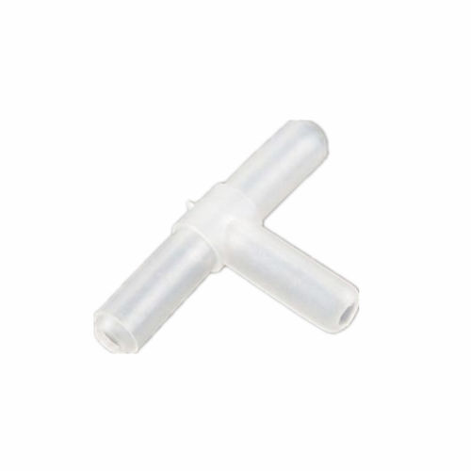
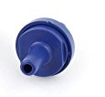
Automatic Fertilizer dosing 1
To mix the water with fertilizer the water pipe pass through a sealed tank. The water pipe has smalls holes to mix the water with fertilizer. The fertilizer is moved to the sealed tank with mini pumps when the water valve is closed.
Water supply pipe
three way connection
One way valve
To the plants
12V Electro Valve
Small one way valve
Fertilizer
Tank 1
Fertilizer
Tank 2
Mini
pump
Mini
pump
Sealed tank.
Water Pipe pass inside the tank. Small holes on the water pipe to mix water with fertilizer
Mini pump
One way valve
Small one way valve
Three way connection

Slide 14
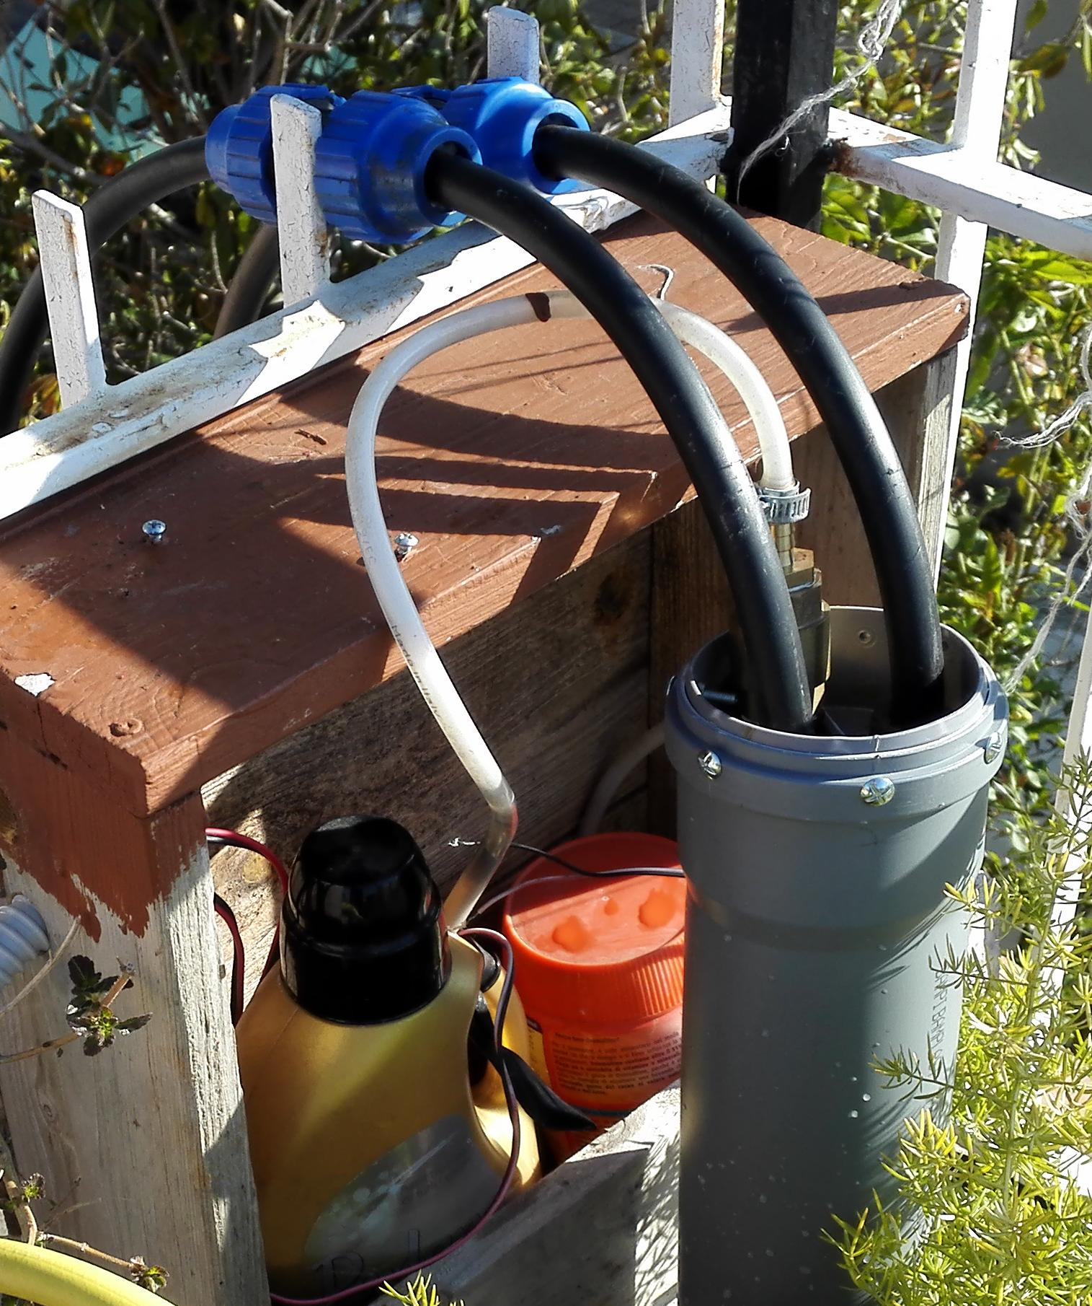
Automatic Fertilizer dosing 2
Below the implementation I made with quite inexpensive materials:
Irrigation outlet pipe
(to the plants)
Irrigation inlet pipe
Fertilizer Pipe
Single way valve
Liquid fertilizer tank.
A mini pump is inside the Tank
Sealed Tank (mix water with fertilizer)

Slide 15
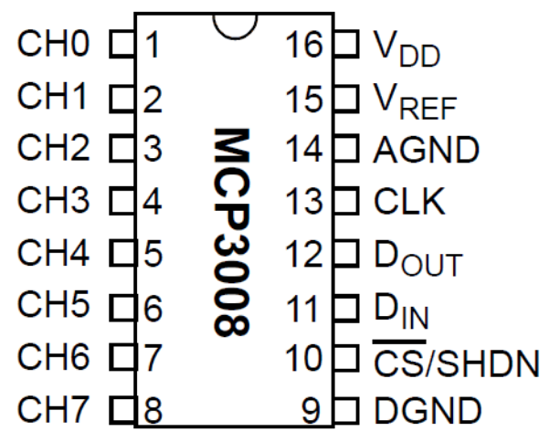
Hygrometer 1
The Hygrometer require the Analog digital converter MCP3008.
Vdd and Vref to +5Vdc
DGND and AGND to Ground
CLK to GPIO11 (23)
Dout to GPIO09 (21)
Din to GPIO10 (19)
CS to GPIO08 (24)

Slide 16
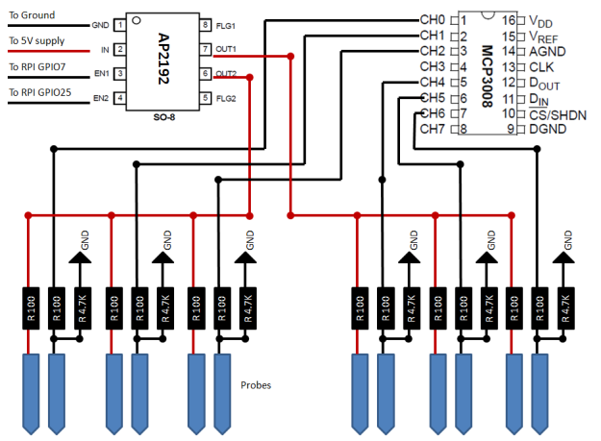
Hygrometer 2
The AP2192 is used to switch ON the current over the hygrometer plates, this to avoid keeping the plates under tension and reduce the corrosion.

Slide 17
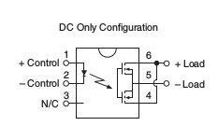
Hygrometer 2 (old)
The LCA110 is used to switch ON the current over the hygrometer plates, this to avoid keeping the plates under tension and reduce the corrosion.
PIN GPIO 07 or 25
vcc
LCA110
GND
GND
830Ω
LCA110
LCA110 Connections:
PIN1 to GPIO 07 or 25
PIN2 to resistor (830Ω)
PIN6 to Vcc (+5v)
PIN6 to PIN4
PIN5 to resistors (100Ω)
100Ω
100Ω
10KΩ
100Ω
100Ω
10KΩ
GND
Probe1
plates
Probe2
plates

Slide 18
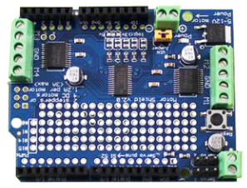
Stepper Motor
The stepper motor shield compatible with I2C protocol is used to control up to 2 stepper motors
Stepper Motor 2
5Vdc:
+5
gnd
SDA
12Vdc
SCL
Stepper Motor 1

Slide 19
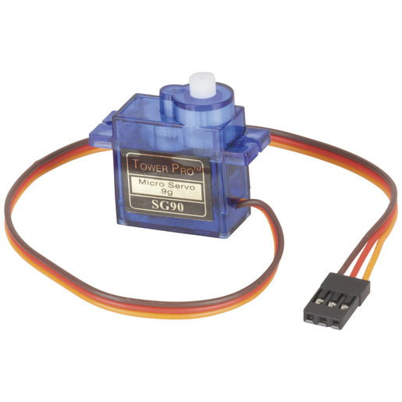
Servo Motor 1
Connection to cheap servo motor.
Black to Ground
yellow to GPIO21 (40)

Slide 20
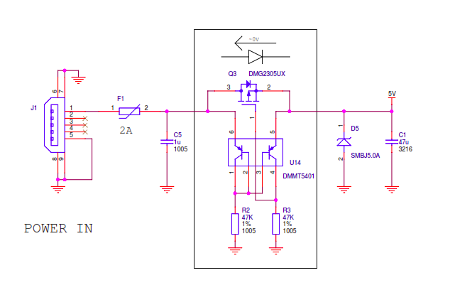
Power Supply raspberry trough PIN
Pin 2 and 4, can be used to power raspberry, anyway they are behind the protection circuit coming from the USB. In case of overvoltage or inversion, the raspberry will not be protected.
Raspberry B Power protection circuitry from USB
PIN 2 and 4
Proposed circuit to Supply 5V to the PIN 2.
Using TVS Diodes SMBJ5.0A and capacitor - (Transient Voltage Suppressors)
Proposed circuit to Supply 5V to the PIN 2 and 4.
TVS Diode + Condenser, (assuming there will be no voltage inversion)

Slide 21
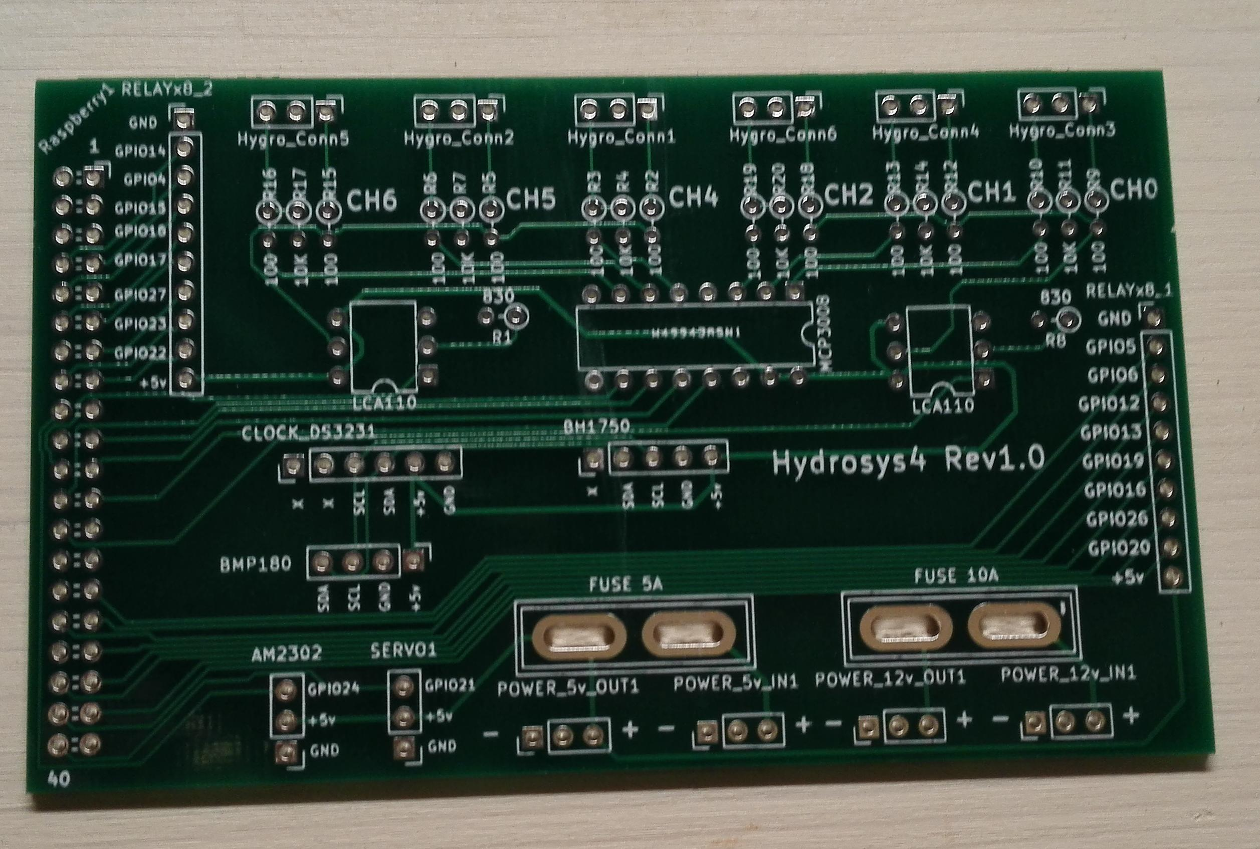
PCB for hydrosys4
This PCB was made to connect all the components of the hydrosys4 project

Slide 22
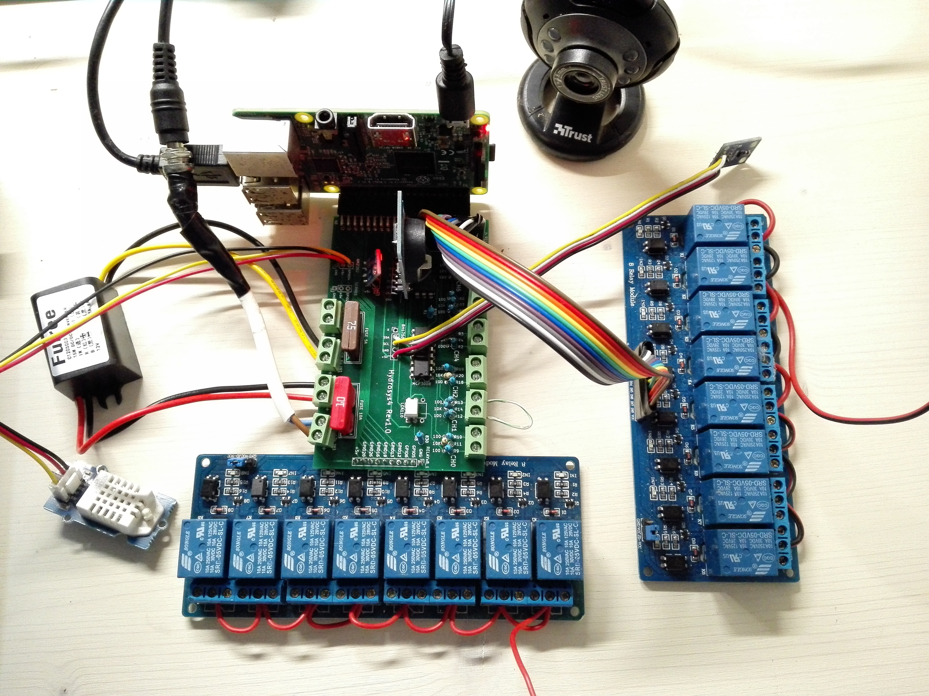
PCB for hydrosys4
PCB with all the components connected
Webcam
Raspberry
Light sensor
Hardware clock
Barometric pressure sensor
Relay x 8
ADC (Analog to Digital) converter
12V input
DHT22 humidity and Temperature sensor
6 connectors for the soil humidity probes
Relay x 8

